Slide 1
AMERICAN REAL ESTATE INVESTMENT
SMART INVESTMENT WITH BIG RESULTS

Slide 2

MAP OF UNITED STATES

Slide 3
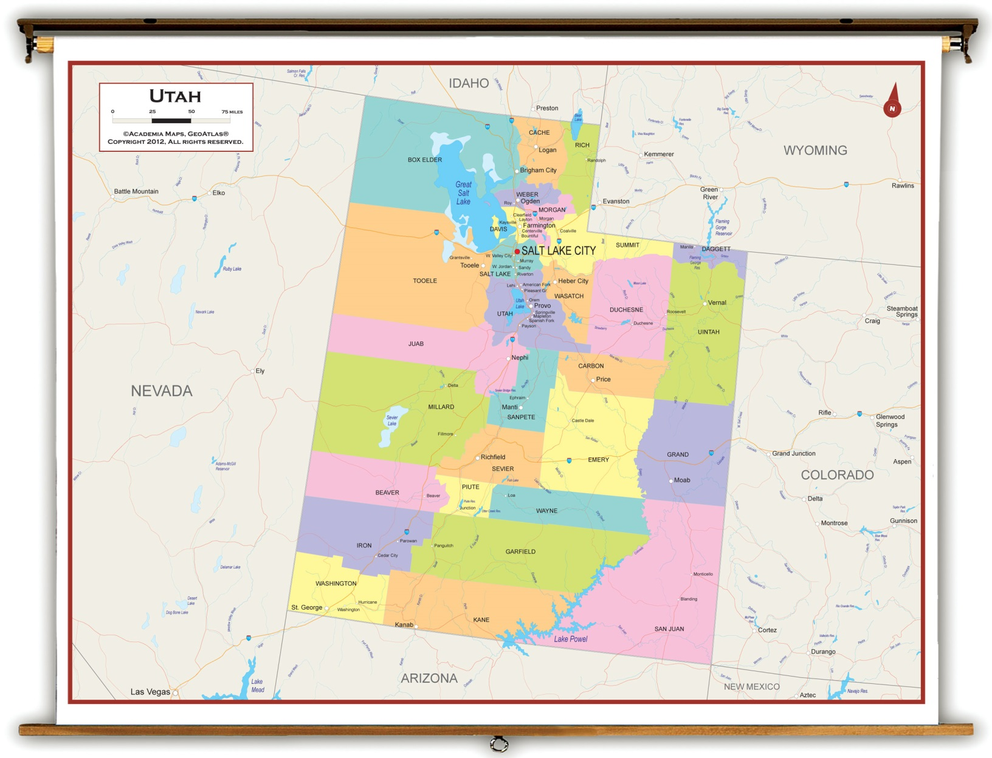
MAP OF UTAH

Slide 4
WHY UTAH
Annual visitors in Utah > 23,500,000 in 2012
“Greatest snow on earth” with 14 Ski resorts in Utah
Year round activities for tourism, including skiing, snowboarding, whitewater rafting, hiking, national parks, Ghost towns, Lake Powell etc….
Rental vacancy rate in Utah @ 7.7% in 2012
2013 Chinese are the second largest foreign buyers of homes in the United States. 7.4 Billion Dollars

Slide 5
Business Outlook for Utah County
NSA (National Security Agency) SPY headquarters
Adobe 100 Million Dollar Technology Campus
Utah County Forbes Top 3 Places to Start Business
Utah Home sales rise for 10 consecutive months
Tourism is growing over 6.25% per year
Unemployment rate in Utah 4.6%
Unemployment rate in US 7.4%

Slide 6
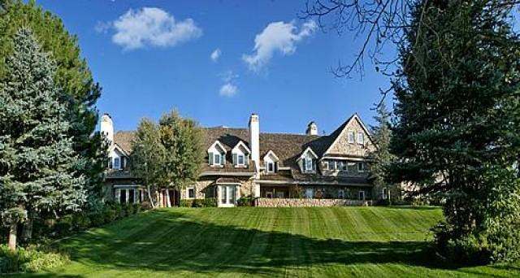
Property Location
Address: Mapleton, UT 84664

Slide 7
Details
Private estate in upscale community
16,337 square ft.
9 bedrooms with 10 baths
Over 6 acres of land
Guest house
Multi-function space for corporate retreat, family gatherings, school functions

Slide 8
Financials
  PROPOSED COST
  Purchase Price: $1,499,000
  Down Payment equal to 20%: 299,800
  Monthly Mortgage: 6,413
  Monthly Utilities and Taxes: 2,056
  Monthly Total : $8,469

Slide 9
Revenue
Vacation Rental Model
Rates:
Period | Weekday | Weekend
May-Sept | $995/Day | $1,250/Day
Oct-Nov | $750/Day | $1,250/Day
Dec-March | $995/Day | $1,250/Day
April | $750/Day | $1,250/Day

Slide 10
Occupancy

Slide 11
Rental Income per Seasonal Month

Slide 12
Net Revenue per Seasonal Month

Slide 13
Additional Net Revenue Variables
Vehicle Rental (12 passenger van) $100/day
Cleaning Fee $150 per stay
Guides Tours to Utah Tourist Locations $50/person
Guided Hunting/fishing Tours $250/person
Horse Back Riding $25/person

Slide 14
Yearly Revenue Forecast
Yearly Net Revenue is $54,846

Slide 15
Projected Investment Value
Investment Value in five (5) years:
(1,499,000 * 7.66) * 5 years = 574,117
Total property valuation in 2018 will be $2,073,117
Net revenue generated: $54,846 * 5 = $274,230
Total investment: $299,800
Total return: $274,230 + $574,117 = $848,347
Rate of return over 5 years: 182%

Slide 16
Contact Details
For more information please contact: Richard Kramer
E-MAIL: Richardpkramer@yahoo.com
We promise to respond promptly to those interested in offers.
More information available here: http://chineseinvestment.blogspot.com/

